Slide 1
Parallel Processors from Client to Cloud
Section 6..1 – 6.6

Slide 2
Hardware Multithreading
programmer’s perspective of MIMD
MIMD relies on multiple processes or threads to try to keep multiple processors busy,
Hardware multithreading allows:
Multiple threads to share the functional units of a single processor
In an overlapping fashion to try to utilize the hardware resources efficiently.

Slide 3
Multithreading Approaches
Two main approaches (Interleaved / Simultaneous)
Interleaved(One pipeline):
Fine-grained multithreading:
A version of hardware multithreading that implies switching between threads after every instruction.
Done in round-robin fashion, skipping any threads that are stalled
Advantage:
It can hide the throughput losses for stalls
Disadvantage:
It slows down the execution of the individual threads

Slide 4
Multithreading Approaches
Interleaved(One pipeline):
Coarse-grained multithreading:
Switching between threads only after significant events (costly stall),
such as
a last-level cache miss.
Advantage:
Less likely to slow down the execution of an individual thread
Disadvantage:
Limited (Due to pipeline startup cost) in its ability to overcome throughput losses (small stall),

Slide 5
Hardware Multithreading
Simultaneous multithreading (SMT)(Multiple pipeline):
A version of multithreading
multiple instructions from independent threads can be issued
It does not switch resources in every cycle
Lowers the cost of multithreading by utilizing the resources needed for multiple issue.

Slide 6
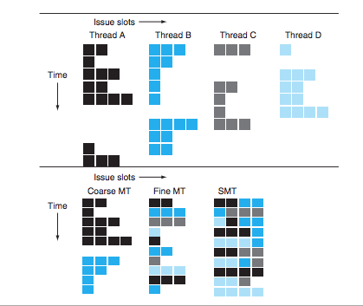
Hardware Multithreading

Slide 7
T/F
True or false: Simultaneous multithreading (SMT) uses threads to improve resource utilization of a dynamically scheduled, out-of-order processor.

Slide 8
Multicore and Other Shared Memory Multiprocessors
Hardware multithreading improved the efficiency of processors at modest cost
The big challenge is the program performance (difficulty of rewriting old programs to run well on parallel hardware),
what can computer designers do to simplify the task?

Slide 9
Multicore and Other Shared Memory Multiprocessors
One answer was to provide a single physical address space that all processors can share (SMP)
The alternative is to have a separate address space per processor
requires that sharing must be explicit;

Slide 10
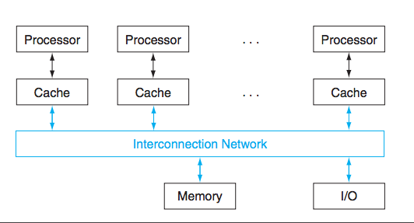
SMP

Slide 11
SMP
Uniform memory access (UMA):
Latency to any word in main memory is about the same
To all processor
Nonuniform memory access (NUMA):
Some memory accesses are much faster than others
Depending on which processor asks for which word.

Slide 12
Synchronization
Synchronization:
The process of coordinating the behavior of two or more processes, which may be running on different processors.
Lock:
A synchronization device (technique) that allows access to data to only one processor at a time.

Slide 13
What we have covered
Section 6.4 and Section 6.5

Slide 14
What Next
Wednesday – 6.6 and review of chapter 3
Thursday – Review Chapter 1
Monday – Review Chapter 2
Wednesday – Review Chapter 4
Happy Exam ..

